Slide 1
Computer Buying Project
by: Patricia Hernandez
Robert Grayson
Lindsey Gonzalez
Diana Fuentes

Slide 2
Scenario # 5
I'm a teachers that needs a computer that I can use at home and take to work. I've used a lot of Appel's in the past and I like the fact that they are easy to use. I only need basic office software. My budget is 1000.

Slide 3
Components, It should be
- Portable (laptop)
- Memory
- Basic Office Software
- Easy to use

Slide 5
Cost:
Macbook Air: $999.99
Lenovo Ideapad: $602.95
HP pavillion dv6000: $699. 99
Dell Inspiron Ultrabook:$429.99

Slide 6
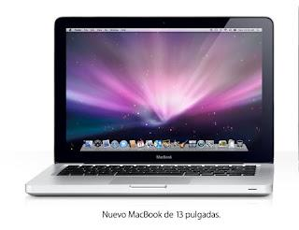
Computer Decision
We choose macbook air because it holds a lot of information (64GB).It's also very low in weight.It's also Very portable to carry anywhere.

