Slide 1
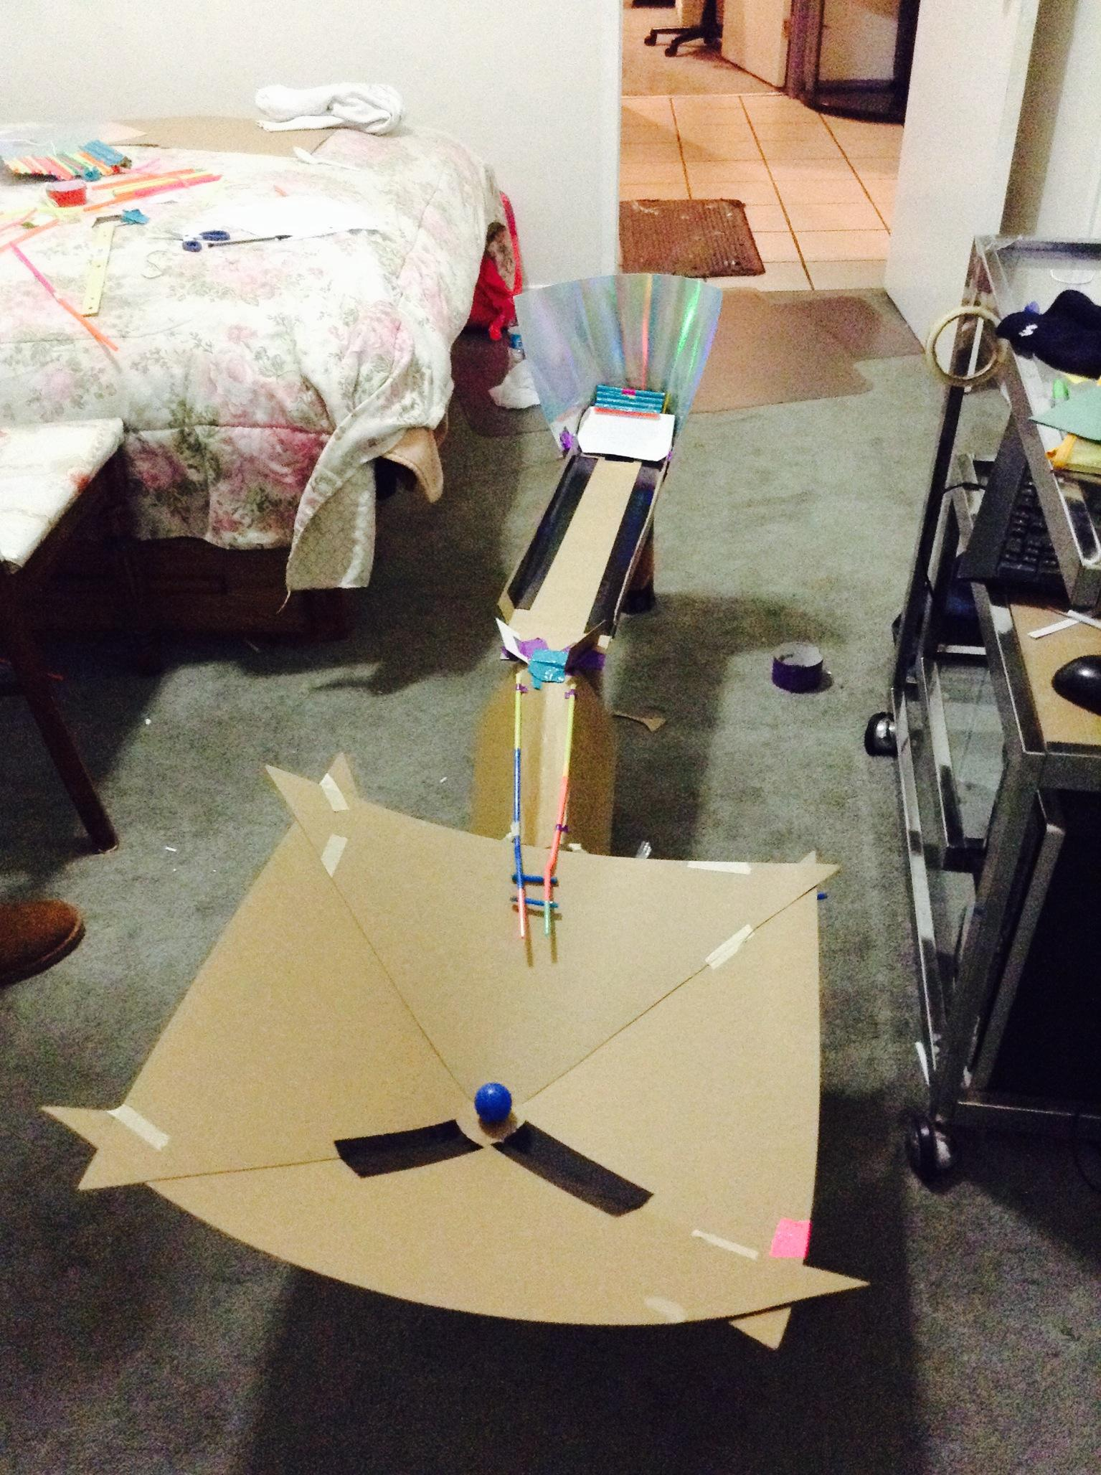
Gravity Machine Presentation
By: Lindsey Gonzalez
Patricia Hernandez
Carolina Menjivar
Catherine Perez

Slide 2
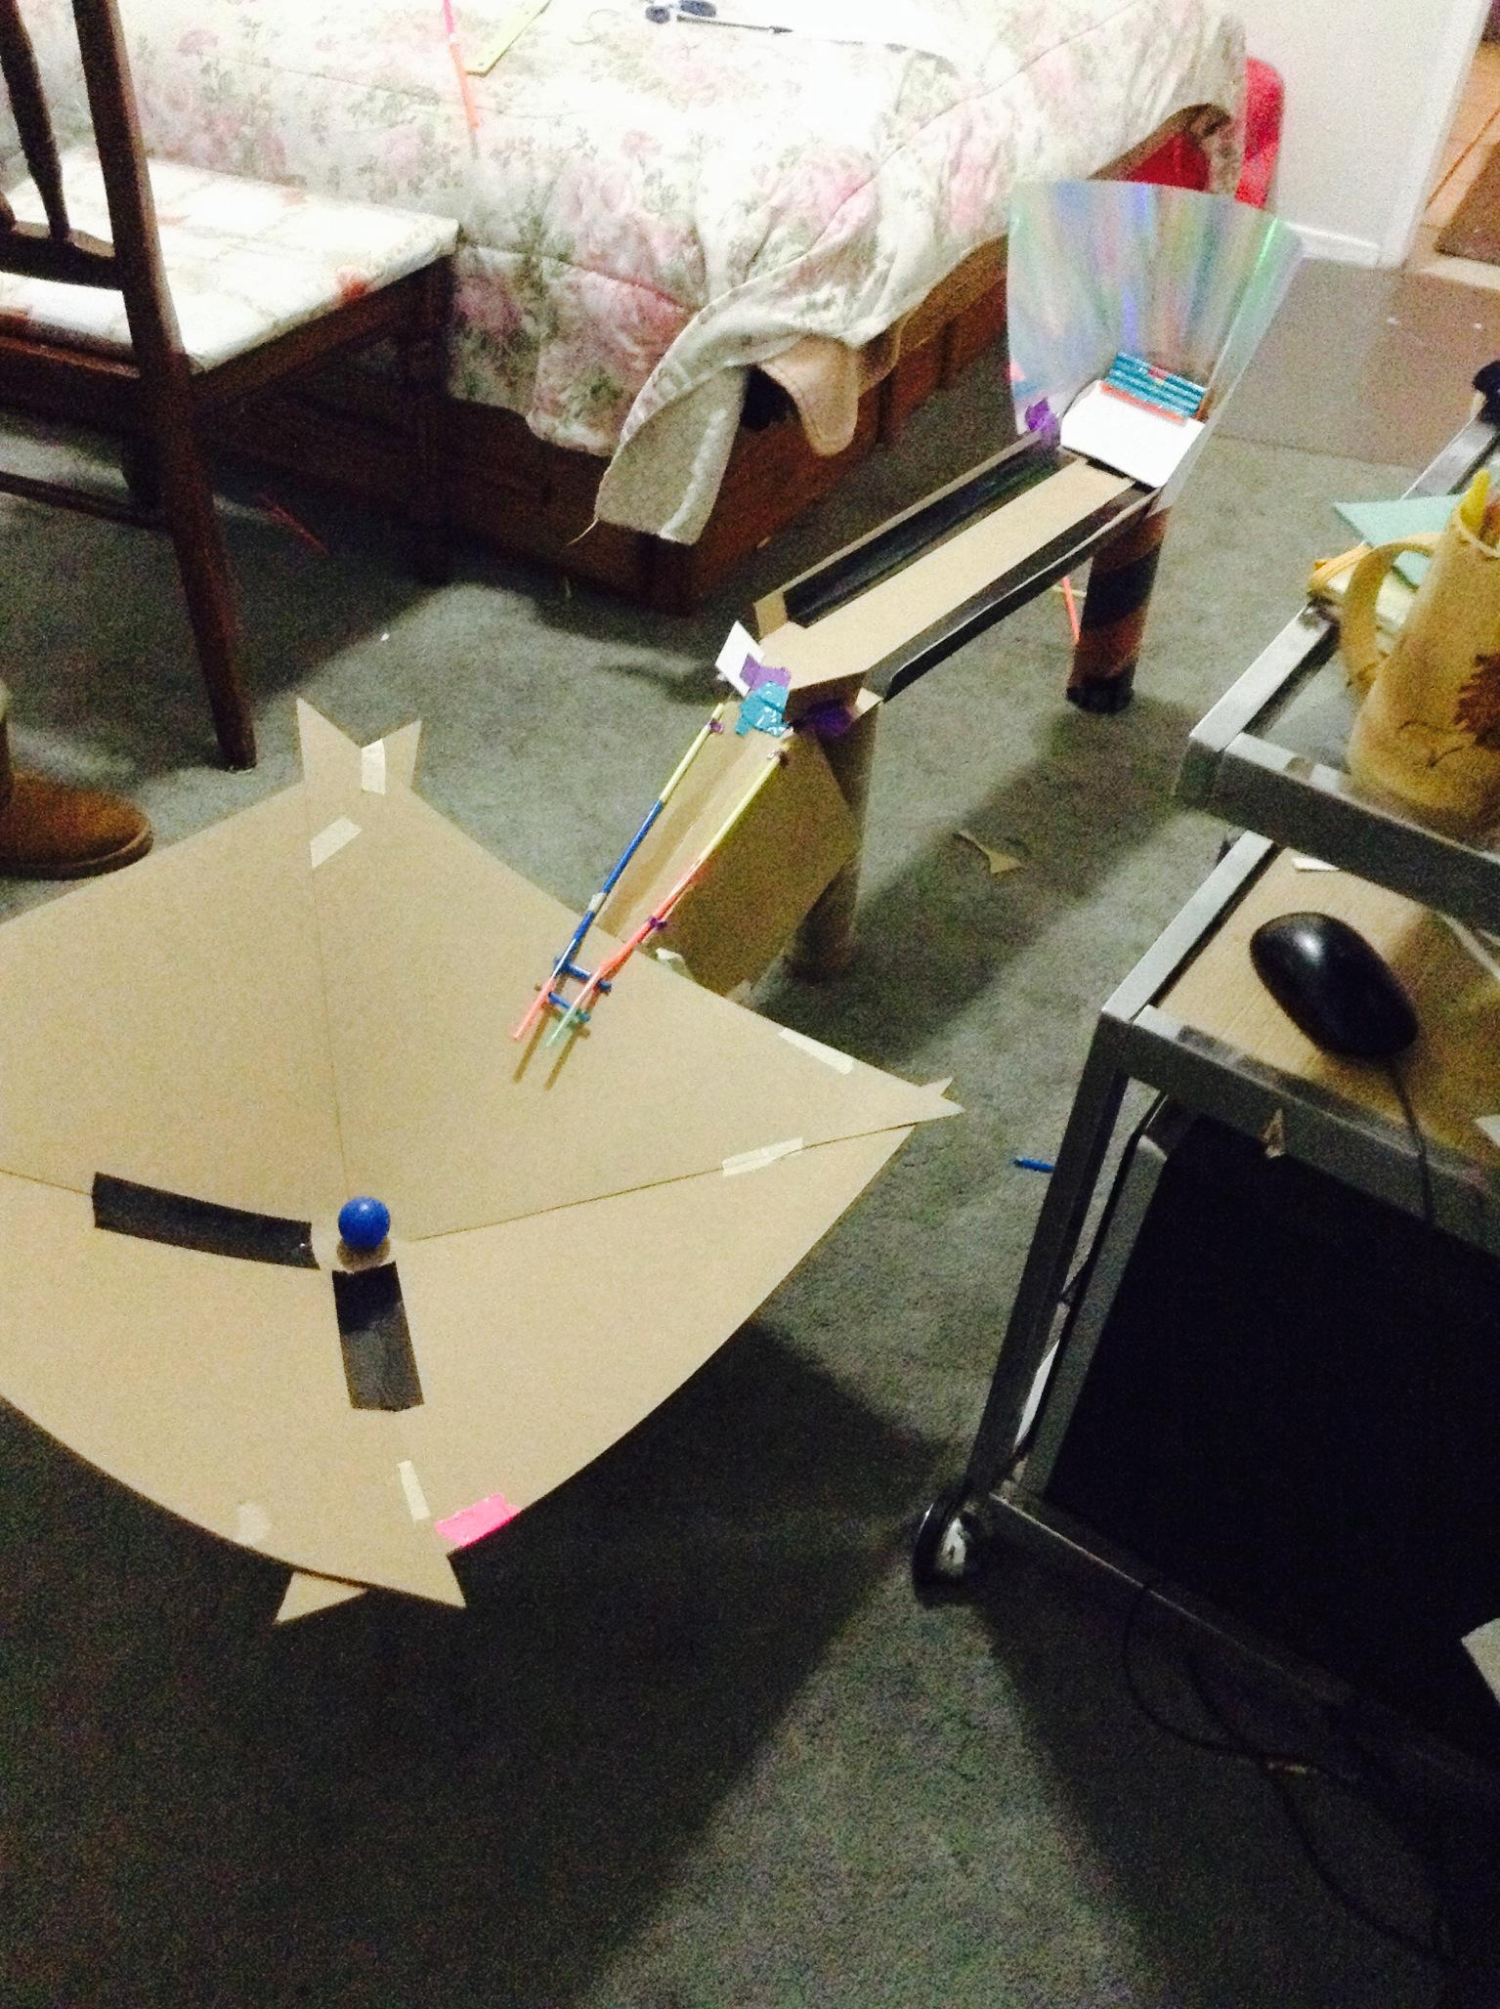
What was this project about?
- The Gravity Challenge was meant for students from the ages 13-18 to create a design that imitates a space mission.

Slide 3
Engineering Design Process
A launch mechanism
-Two different stands for our spoon launcher.
-Three different launching objects.
An orbit transfer mechanism
A gravity well that simulates the orbit
-Thick paper board that we shaped into a semi-bowl.

Slide 4
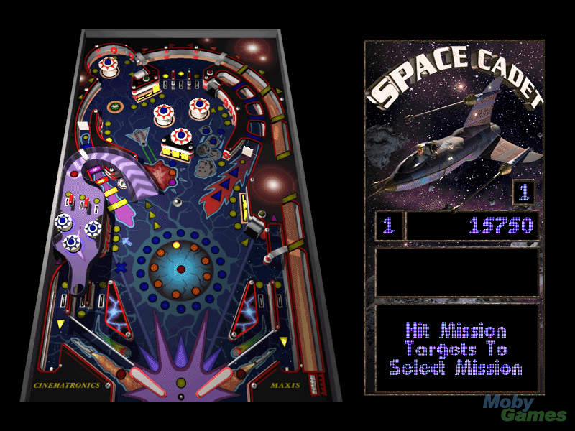
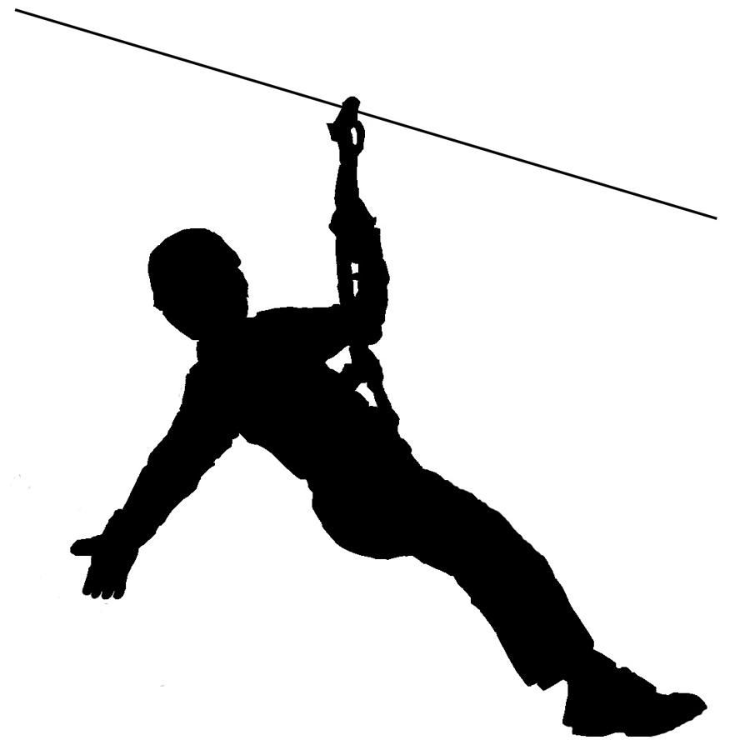
Where we got our inspiration
An outside activity called zip line.
The game Pinball.
Childhood memories.

Slide 5
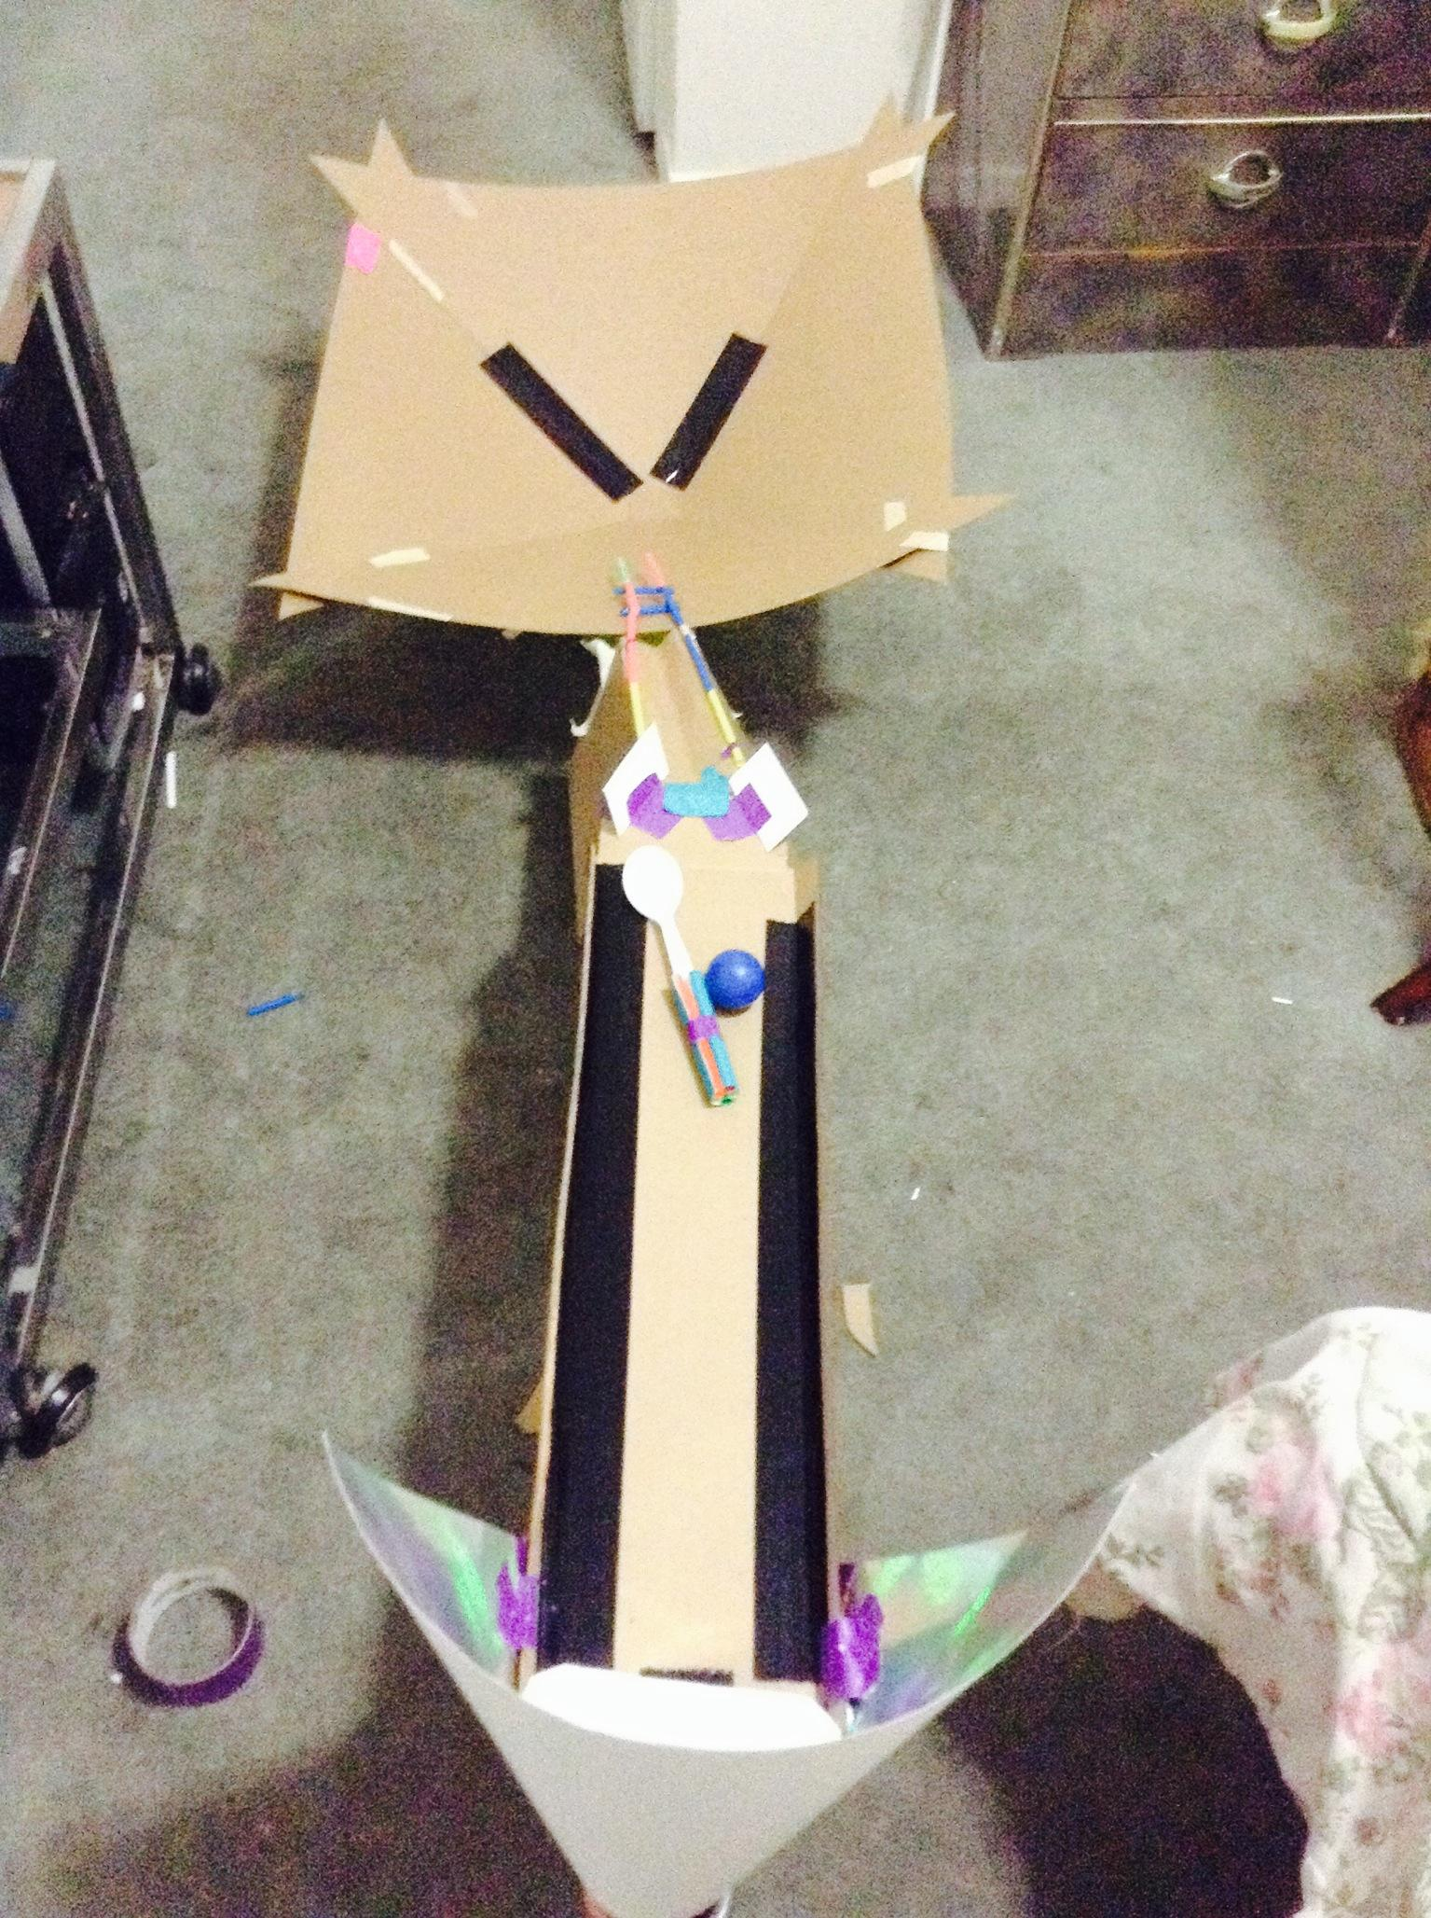
STEM (Science, Technology, Engineering,
Math) that went through your design.

Slide 6
Vocabulary:
- static - mass -engineering design process
- dynamic -inertia - brainstorming
- acceleration -free body - moments
- deceleration -free fall - orbit
- potential energy -force - satellite
- kinetic energy -gravity - Newton’s laws of motion
-momentum -power

Slide 7
Demo of our machine.

