Slide 1
Sensitive Personal Information
By: Diana Fuentes
Lindsey Gonzalez
Patricia Hernandez
Robert Grayson

Slide 2
What Is Sensitive Personal Information?
Sensitive personal information is a part of information that people have on their accounts or membership such as credit card information, social security numbers, and other information
that people would want
to steal from you.

Slide 3
How People Use Your Personal Information (Pros )
Big companies use your personal information for many reasons. A reason that companies use you personal info like Ebay is to help ease the stress of searching for items.

Slide 4
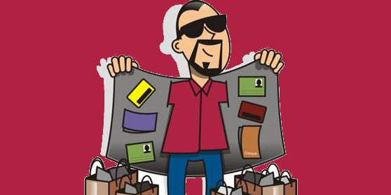
How People Use Your Personal Information ( Cons )
Although companies usually use your information to help you more, other companies use your information to hurt you instead of helping you.
Thug Life

Slide 5
Microsoft just
took money from his credit card
Microsoft Scum

